Slide 1

IIT Bombay Racing
EV electrical and electronics

Slide 2
ELEC SUBSYSTEMS
LV
Safety system of the car
HV
Battery stack and Battery Management System
INTEGRATION
Planning of circuits on the car
Data Acquisition and Instrumentation
SOFTWARE
Control Strategy for ediff
Electronic differential hardware
HV motor controller
Wire harness for interconnections within the LV/HV systems
Modelling and simulations of vehicle systems (especially related to e-diff)
Real Time Operating Systems

Slide 3
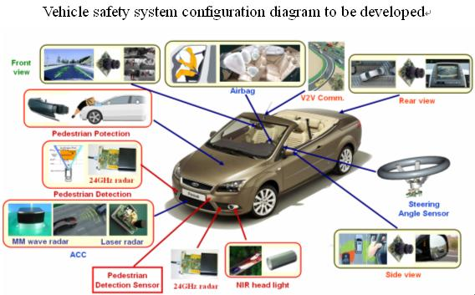
Safety Systems
Ensures safety of the car and the driver
Part of the rulebook requirement of the FS competition
Most crucial circuit for the car

Slide 4
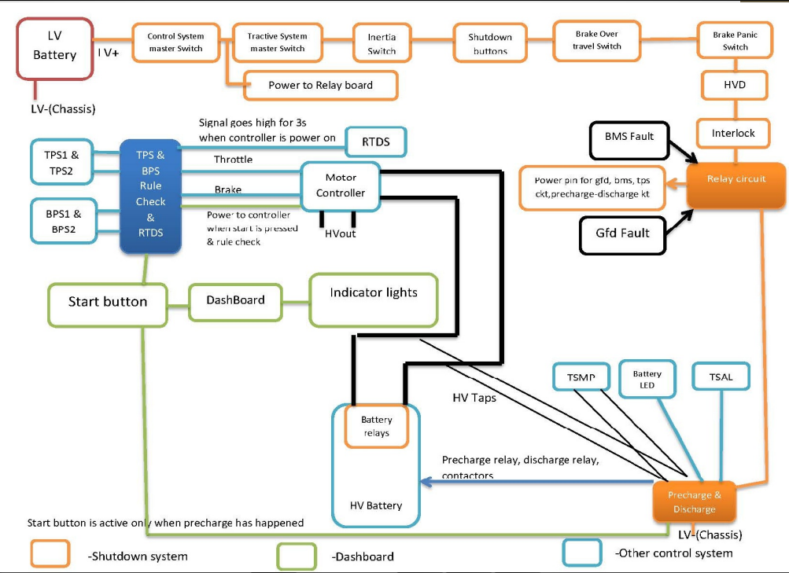

Slide 5
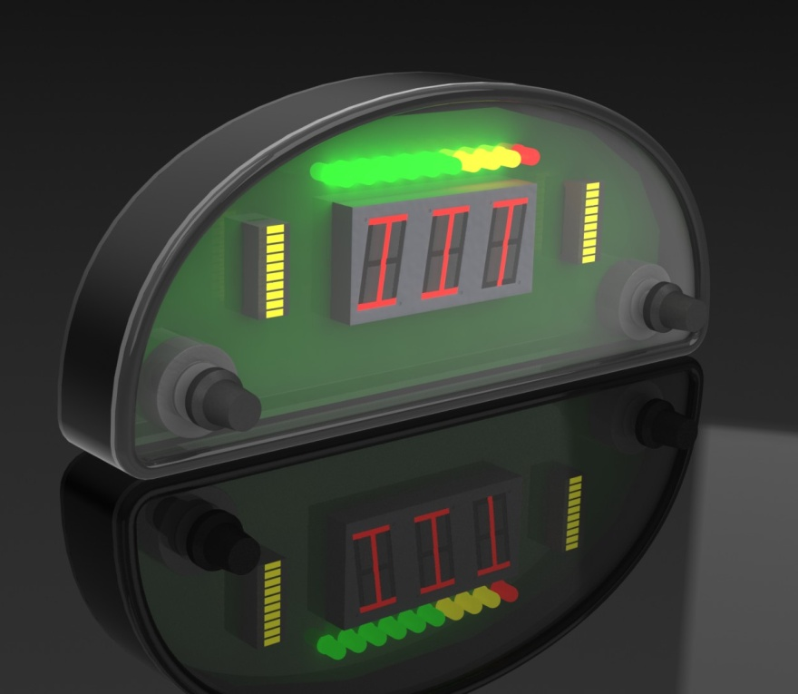
Data Acquisition and Instrumentation
Data Acquisition : Capturing around 20 vehicle parameters using On-board sensors
Implementation of Single Board Computer on car
Use of higher level protocols such as CAN, Ethernet for faster communication between electrical systems
Dash: Developed the instrumentation panel in collaboration with IDC to improve on aesthetics

Slide 6
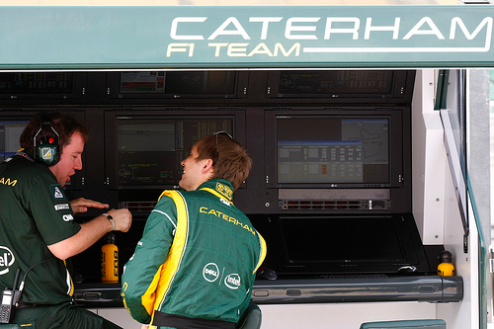
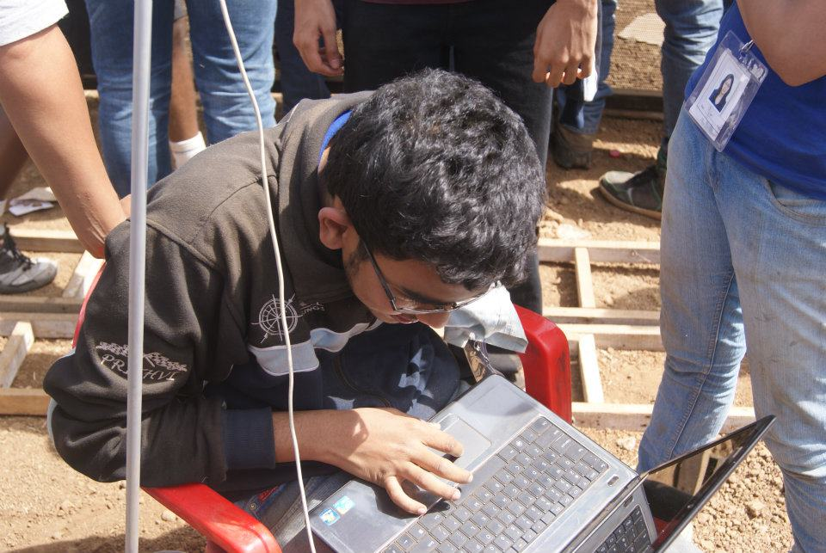
Time for a story! :p

Slide 7
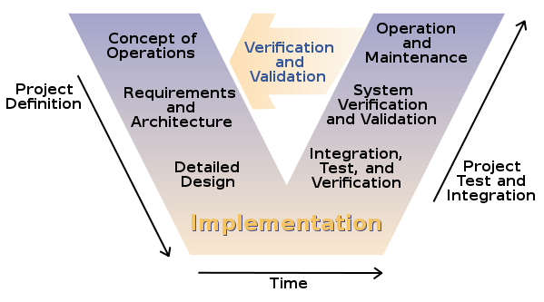
Electronic Differential : Introduction
Aim :
  To utilize the maximum traction available on the tires in order to achieve optimum performance in racing conditions
  To improve vehicle performance over mechanical differential
Robust Modeling → Development of Control System → Extensive Analysis & Comparison by simulating different methods → On-road testing → Analysis of acquired Data → Tuning of control parameters
HIL simulations : Custom designed the device for HIL simulations
Time for a small VIDEO!

Slide 8
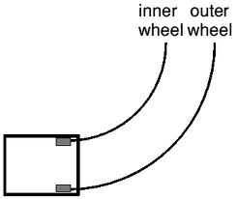
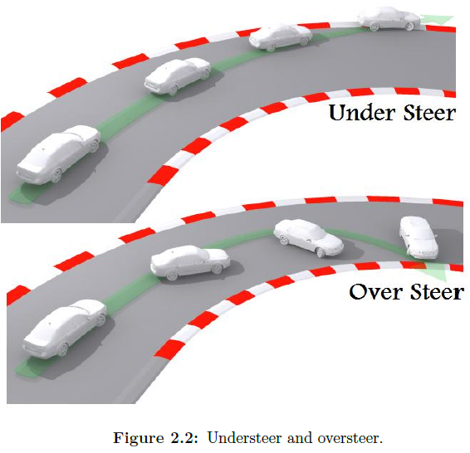
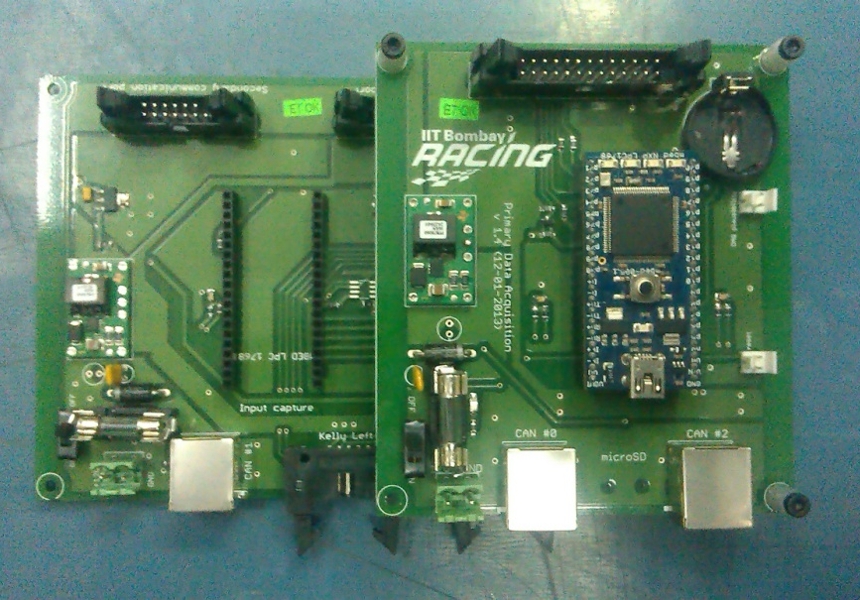
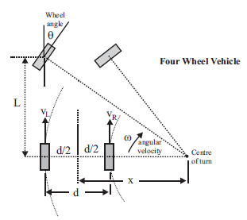
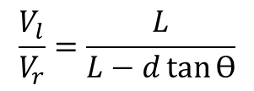
Electronic Differential: Basics
$$\frac{V_{l}}{V_{r}}=\frac{L}{L−d\tan{Ѳ}}$$

Slide 9
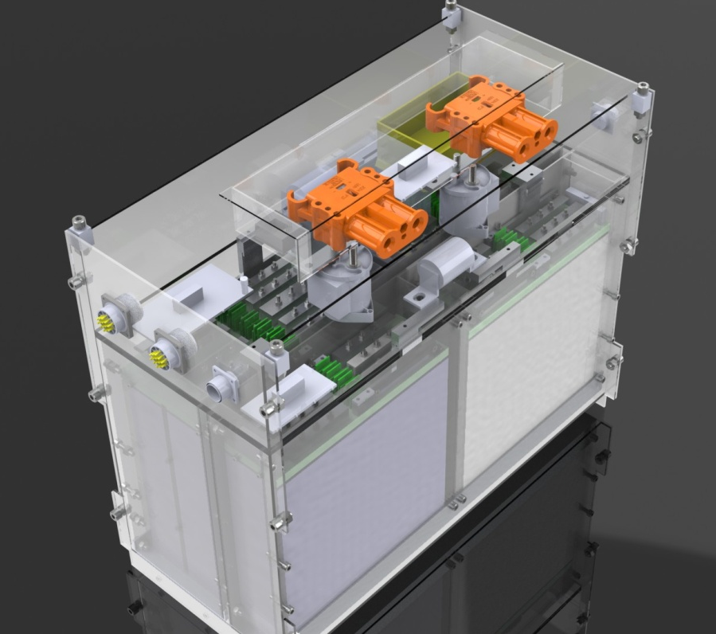
HV Systems
Thing that powers the vehicle
Lithium Polymer battery 84 volts -2 banks in parallel
Battery Management System
Charging System
Runtime Battery health monitoring
Lets see what happens without BMS

Slide 10
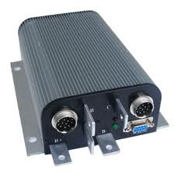
Controller
A “Stud” L293D of your car
Can be programmed
Essentially a capacitor in nature..problem ! Why?
Precharge, Discharge circuit
Team working on custom developed controller

Slide 11
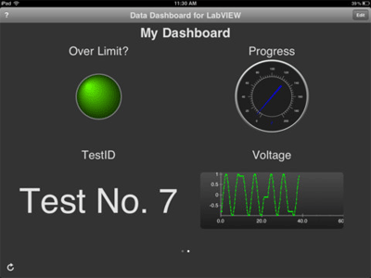
Software
Making the car think – putting codes in its brain
Putting mathematics in theory into reality using awesome features of a microcontroller
Real time data monitoring GUI
Android app for data acquisition

Slide 12
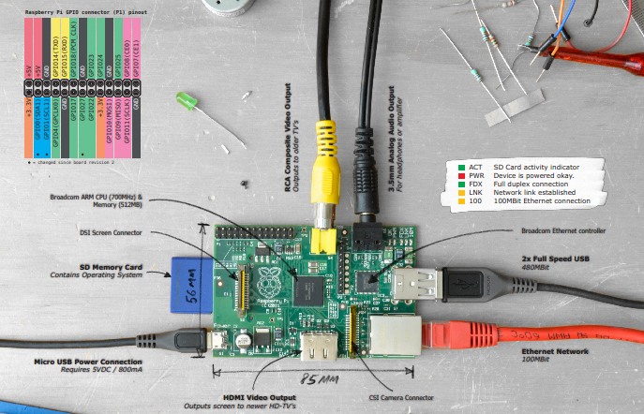
85 mm computer we work on! Cool isn’t it?

Slide 13
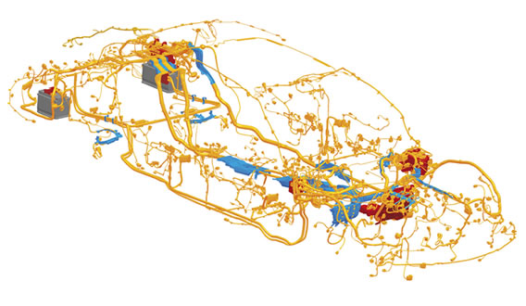
Integration
Differentiates a car from a robot
Crucial subsystem for smooth functioning of car
We can’t afford our L293Ds to blow up once in a day :P
Bridge between mechanical and electrical subsystems
TSAL, RTDS, Debugging System

Slide 14
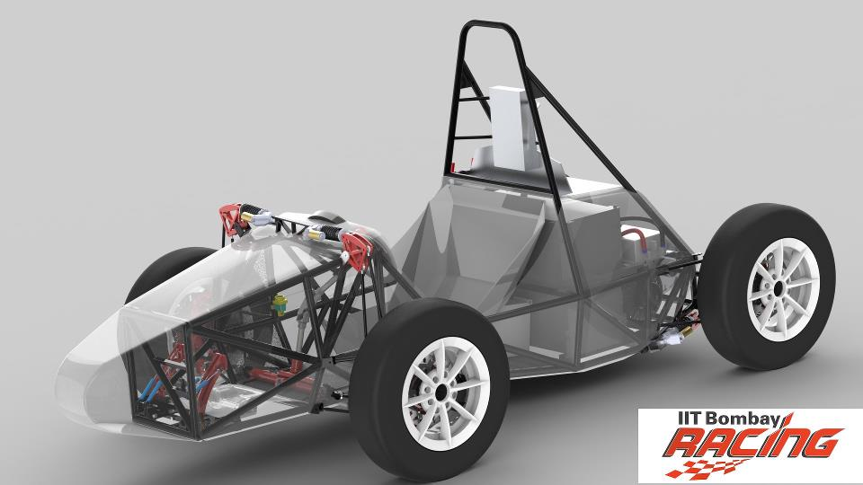
Lets discuss!
LV Systems
HV Systems
Softwares
System Integration

